Slide 1
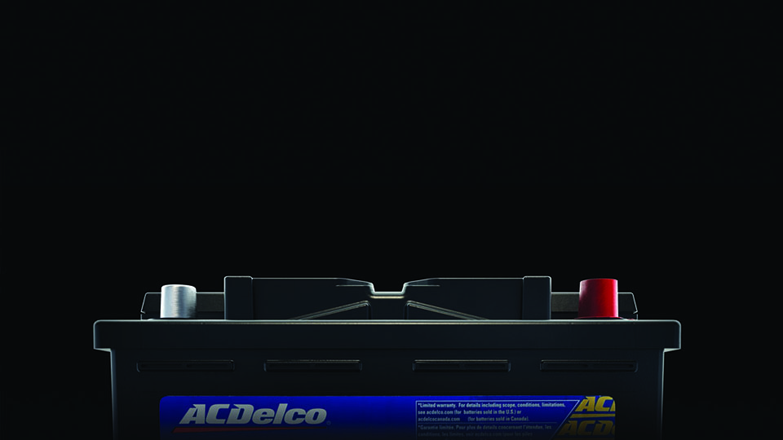
Acdelco batteries

Slide 2
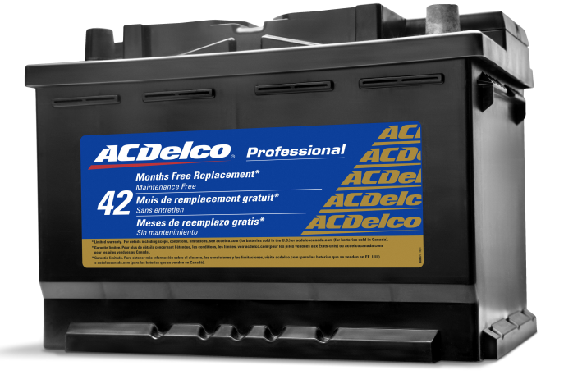
Laboratory-tested, field-proven and backed with outstanding warranty coverage, ACDelco Batteries set the standard for performance!
Patrick Manning – Account Manager
Kirk Simpson – ebusiness Coordinator
Chad Cannon – Product Manager

Slide 3
Agenda
Why ACDelco?
Tools: ACDelco.com catalog and connection catalog/features
Product: Updates
2020 Program and marketing catalog

Slide 4
Are acdelco batteries different?
Answer: Yes and No
All Batteries:
  Manufactured by the same processes – plants need consistency
  Have the same ‘components/guts’
ACDelco battery difference: The Secret Sauce!

Slide 5
The ACDelco Difference
ACDelco is GM original equipment
ACDelco supports the use of OE specs (Professional): Formulation & Quality of Paste, Electrolyte, Lead
  Other brands must reverse engineer our GM OE specs
  RC can be more important than CCA for battery life
  You don’t need more CCA than the original part
Notes:
Most aftermarket companies focus only on CCA because that’s what’s always been done
ACDelco is about balance
Selling point
With the additional electronics including Wi-Fi connectivity in vehicles it will be important to:
“Power your accessories AND start your car”

Slide 6
Why ACDelco?
Legacy of Excellence – 100 year History & nationally recognized brand
Unparalleled Support – marketing, training, catalog & selling tools
The RIGHT Technology – not just the ‘latest’ spin or one gimmick
Wide AND Deep Portfolio – 240 part numbers: Automotive, Heavy Duty, Marine, Powersports, Lawn & Garden, Industrial, Electric Vehicle
Features and Relentless Improvements – The little things count
All these lead to CONFIDENCE

Slide 7
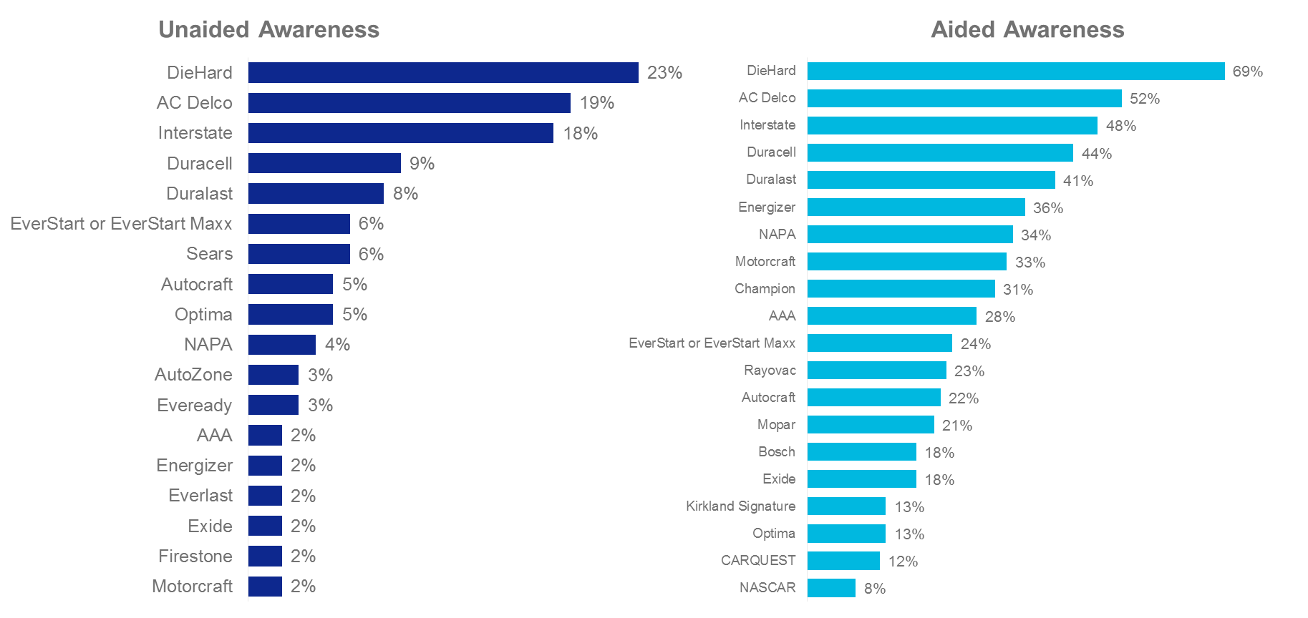
Brand / Outlet Awareness Research
AC Delco Ranks #2 in Unaided and Aided Awareness - total Awareness ranked #2
21pts behind DieHard and +5pts above Interstate
Source: Kantar Research – Brand & Outlet Awareness Study 2018; N=2.000; Top 20 shown
Notes:
Purchased a battery in the last 36 months (end consumers)
Baby Boomers and Sears news (Craftsman sale and legal issues) keeps DieHard in the mix
EverStart is Walmart
Everlast is AutoZone
Duracell data is spotty due to consumer confusion but increasing
PepBoys has Bosch on shelves and their Champion Brand

Slide 8
What does this mean for You?
OEM specs to give you the right part, with higher quality and greater validation
FIRST to market for GM Applications
Iconic Brand
Full offering for all your customer needs
Great marketing support and tools to help you sell more batteries
Notes:
This knowledge can help you prepare your Customers to take on and tackle new technologies
We have been talking about RC and AGM for several years to prepare all of you – now the market is really shifting!

Slide 9
How to best your customers
Help dealers and shops to maximize their battery sales by doing these three things:
Ensure the correct product for their market and priced right!
Promote testing in the Dealer Service Lane and Independent Shop
Market/Product Display in the Shops and Service Lane
Notes:
Consider AGM is growing for newer Start-Stop Vehicles
Consider where customers may go to price batteries and be ready to help them understand the value the Dealer provides with system resets / re-programming etc.

Slide 10
Catalogs

Slide 11
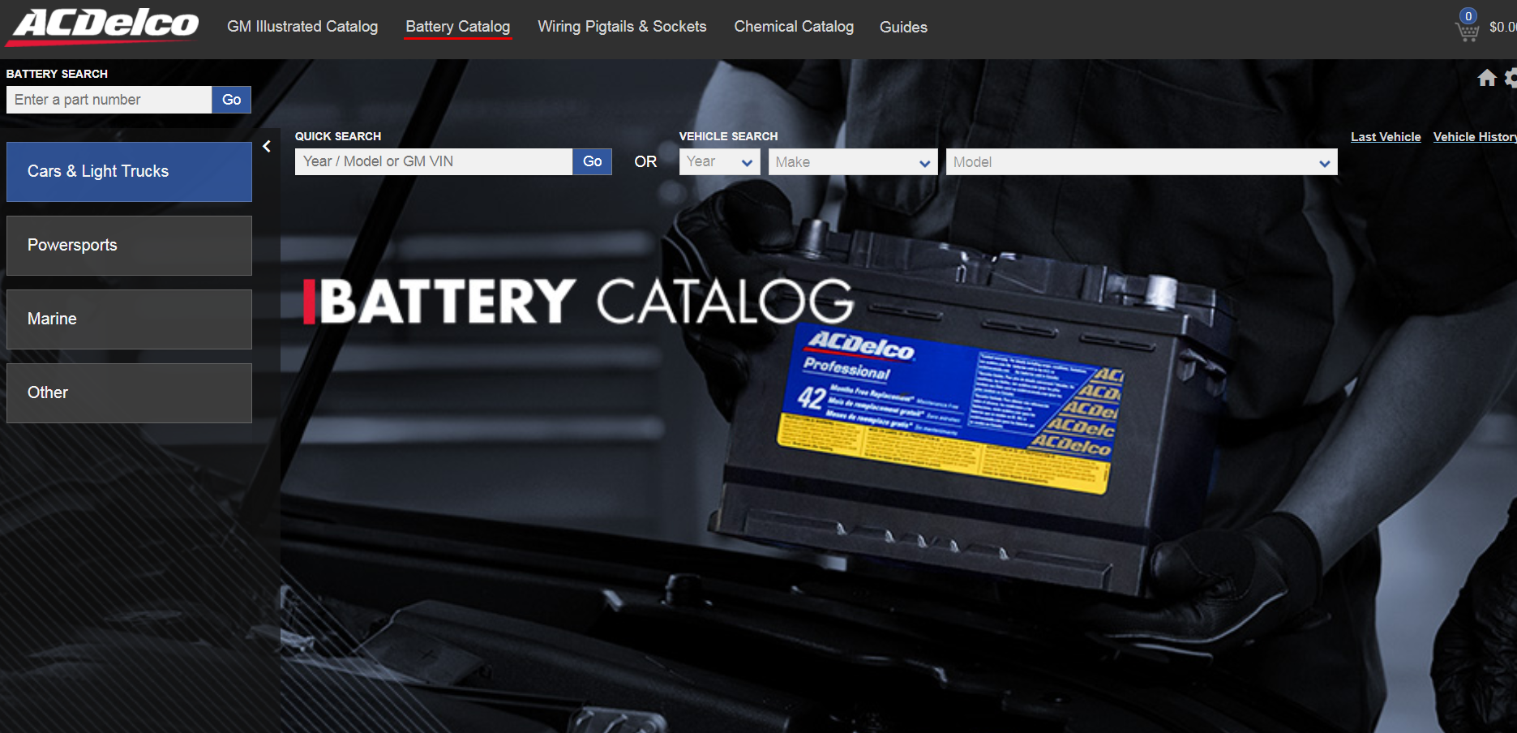
CONNECTION: Battery Catalog
Notes:
IN Discuss: ACDelco TechConnect website, in particular how to navigate the online battery catalog, The battery catalog is now referred to as “Connection”

Slide 12
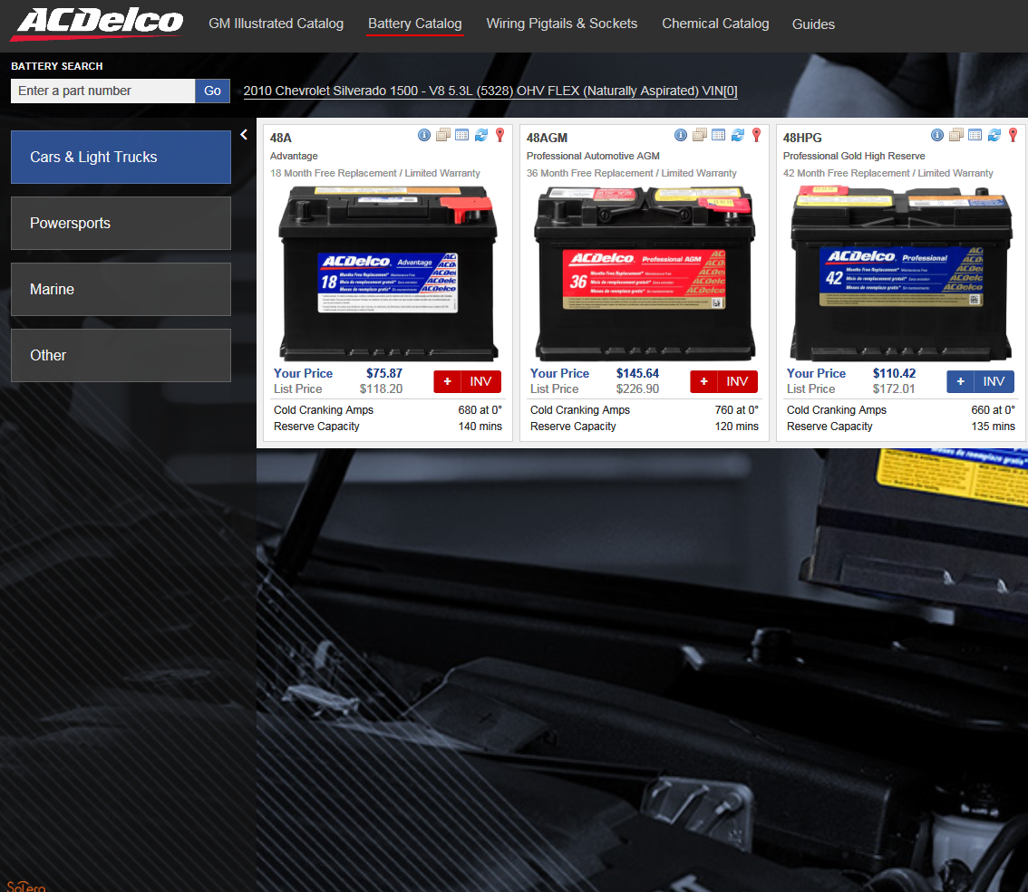
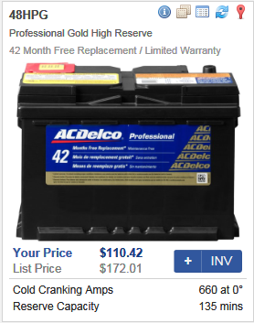
CONNECTION: Battery Catalog
Battery Comparison Tool
Group and CCA Info
Technical Data
Battery Locator
Reset Procedures
Part Number
Warranty Info
Add to cart
Inventory Check
Notes:
IN: Discuss the online catalog, maybe launch it and navigate around.
IN: Vent tube part numbers are in noted as a footnote in the Battery Catalog

Slide 13
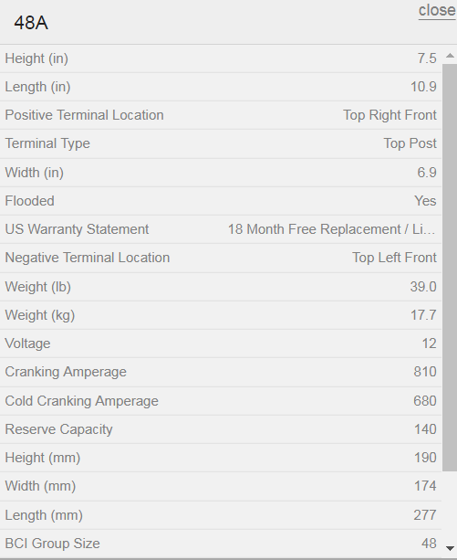
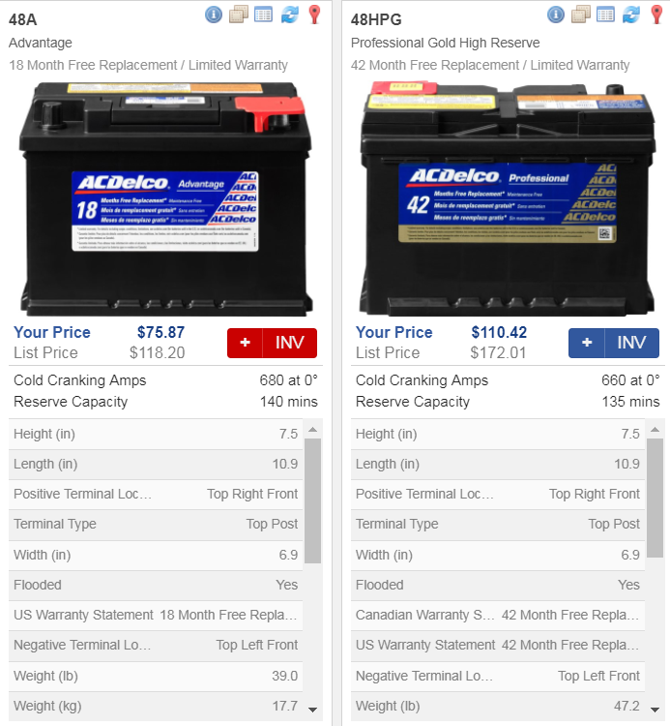
Technical Data and Comparison feature
Easy one-click popup window displays all relevant technical data, including group size, Reserve Capacity, and Dimensions.
Battery Comparison feature allows a side-by-side overview of each battery available for the application, including technical data.

Slide 14
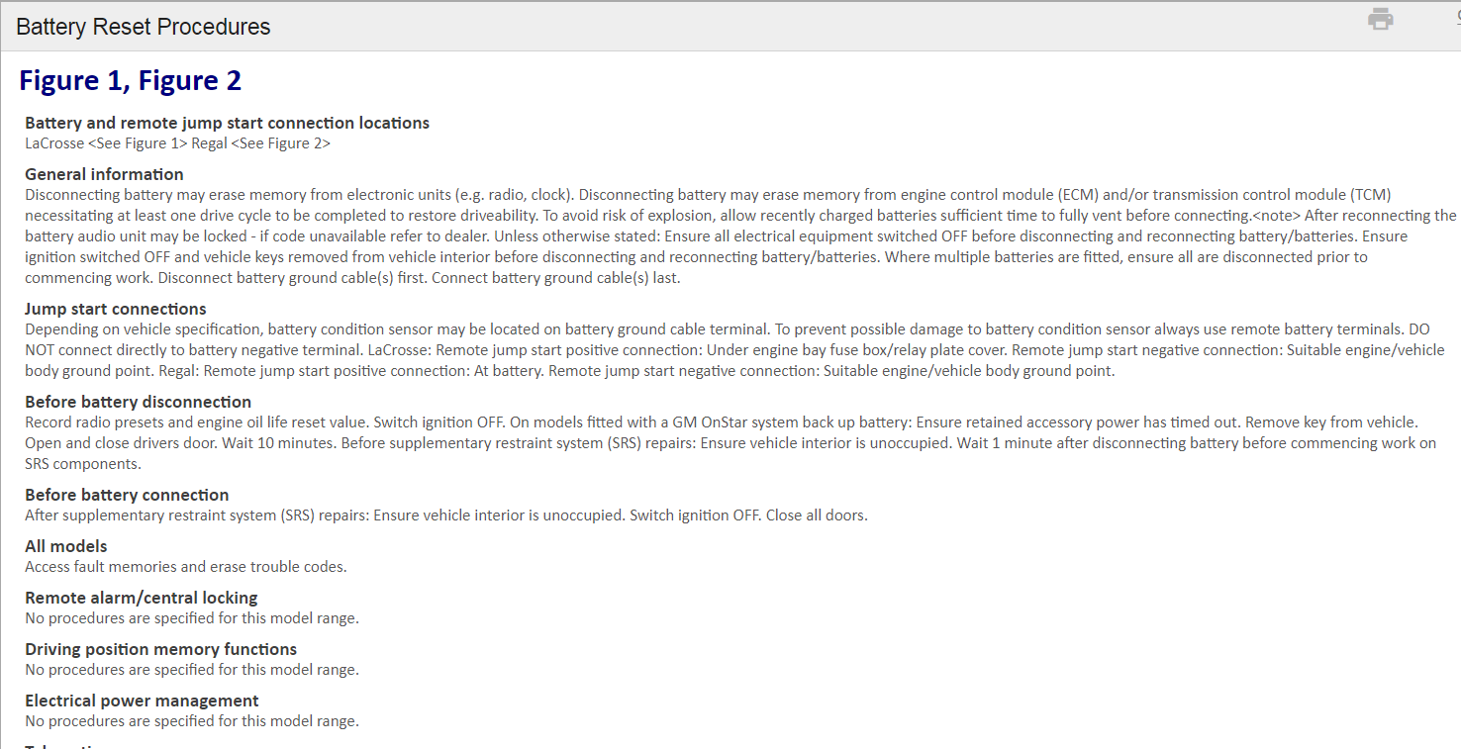
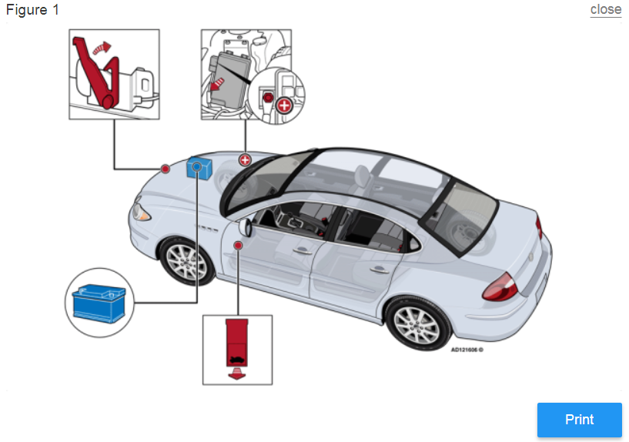
Reset Instructions and Locator
Notes:
IN: Discuss the online catalog, maybe launch it and navigate around.
IN: May want to discuss that in some vehicles the battery is monitored by a control module, the input and output current is measured. This system can perform load shedding which is the disabling of non-essential electrical loads. When replacing a battery the battery has to be registered to the module using a scantool. This resets the energy balance counter. Some vehicles that have this include certain Audi, BMW, and Mercedes-Benz vehicles. There may be others as well. In addition the power window express function/pinch protection may need to be reset, as well as radio anti-theft codes. Memory presets for radio, seats, and mirrors may be cleared during battery replacement. And don’t forget the clock. I have included a folder in the instructor resource folder that contains information on the battery manager found in the imports, it is for the instructors use only, do not distribute.
IN: Questions regarding the use of Connection and LIT should be directed to your local ACDelco representative.

Slide 15
Product Update

Slide 16
New Additions for End of 2019
Adding:
  94RAGMHR - alleviate capacity issues on 94RAGM plus add a High Reserve option
  49AGMHR - High Reserve option not widely available
  M27AGM - Excellent combination Deep Cycle and Cranking performance
Replacing:
  31AGMCRT and 31AGMCRAT (lost supply base*) with 31AGMCT and 31AGMCAT
    Improved Reserve Capacity AND lower cost! ($10 lower WD)
Updating:
  65AGMHR replaced with 65AGMHRC with new case for additional fitments
*Note: Replacing Deep Cycle 31 AGMs in 2020 with 31AGMDM capable of 800 cycles at 80% DOD
Notes:
Add first batch in December. 94s had large OE backorder last year so this is to ease capacity and upsell to HR version. M27 is new and great option for Marina yachts
Second batch coming in December. We’ve been out of stock for 1 year
3. Adding 65s Q1

Slide 17
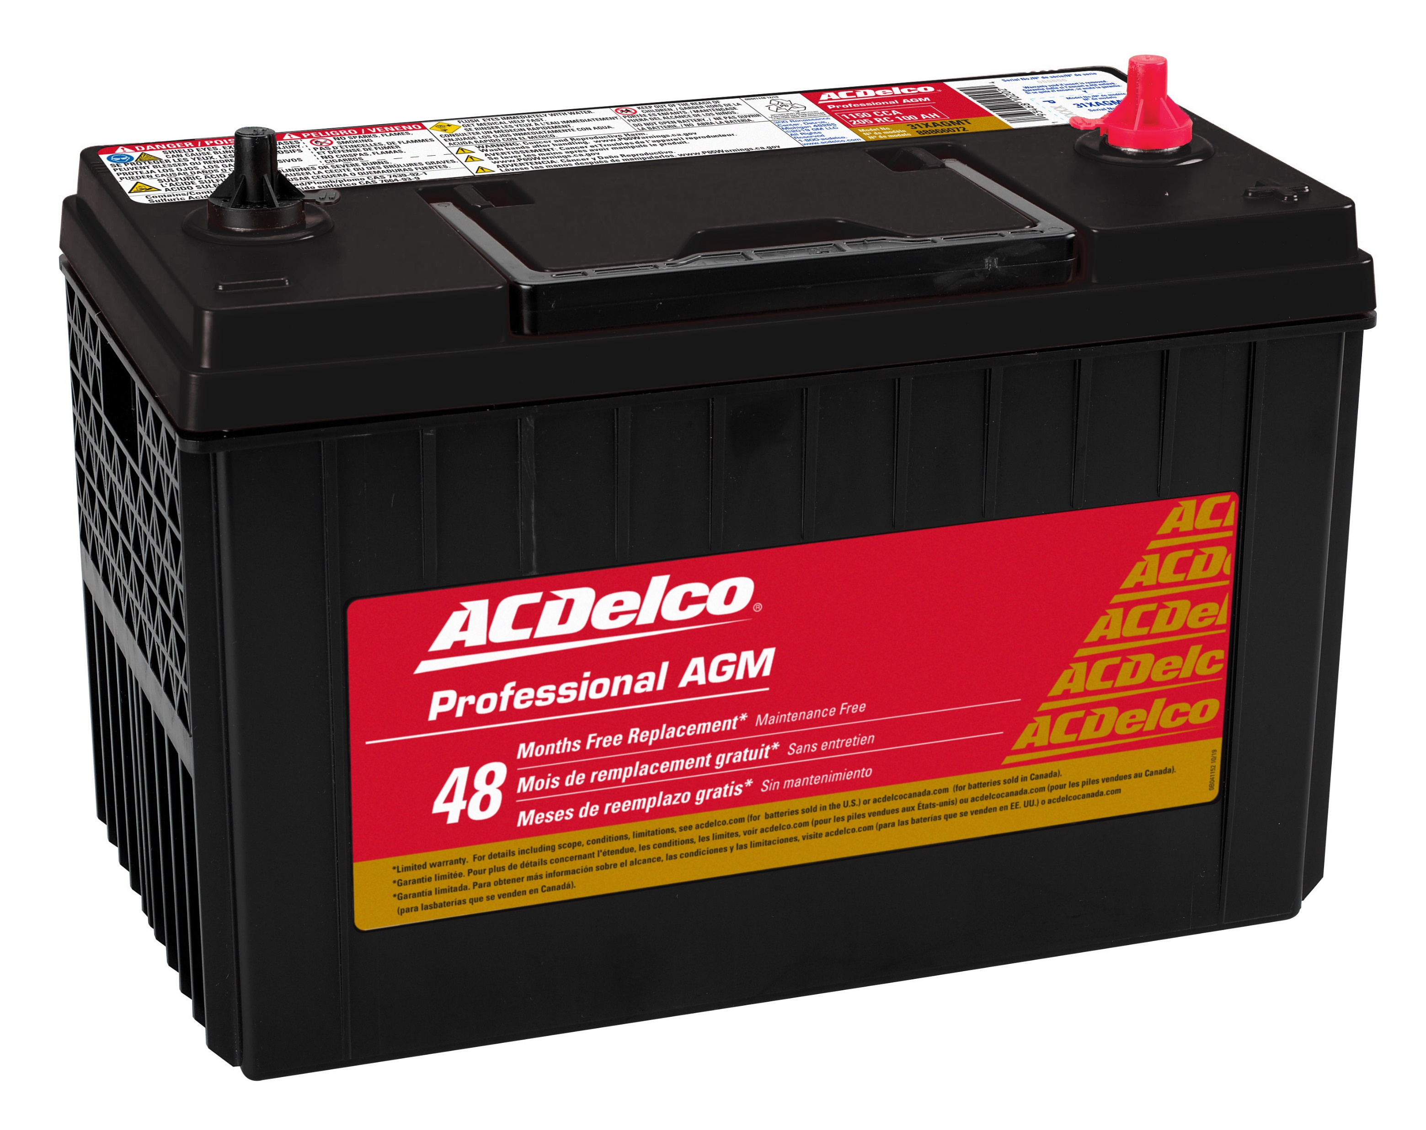
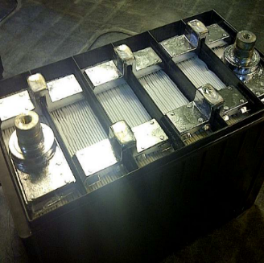
Premium Enhanced ‘XAGM’ Line
Featuring Virgin Pure Lead plates and ultra pure electrolyte
Military grade construction and Specifications
  Epoxy bonded plates and tops
  Super thick over-wall inter-cell connections
  Enhance terminal construction with O-Ring seals and ribbing
  High Strength Polycarbonate cases
  Highly refined fine particle paste
True Combination Performance with 400 cycles at 80% DOD
Competitive pricing and warranties with Odyssey Premium AGM
  An ACDelco Optima Fighter!
Timing: 1Q20
Bulletin, Sell Sheets, etc.
in development now!
Notes:
How do these enable true combination performance?
>> Combination of construction elements like the over wall connections enabling bigger grids and more acid in same size case (higher overall weight!)
>> And the chemistry of pure lead and special paste formation enable more thin plates to still perform well in deep cycling mode
Higher shelf life, lower self discharge, amazingly fast charging

Slide 18
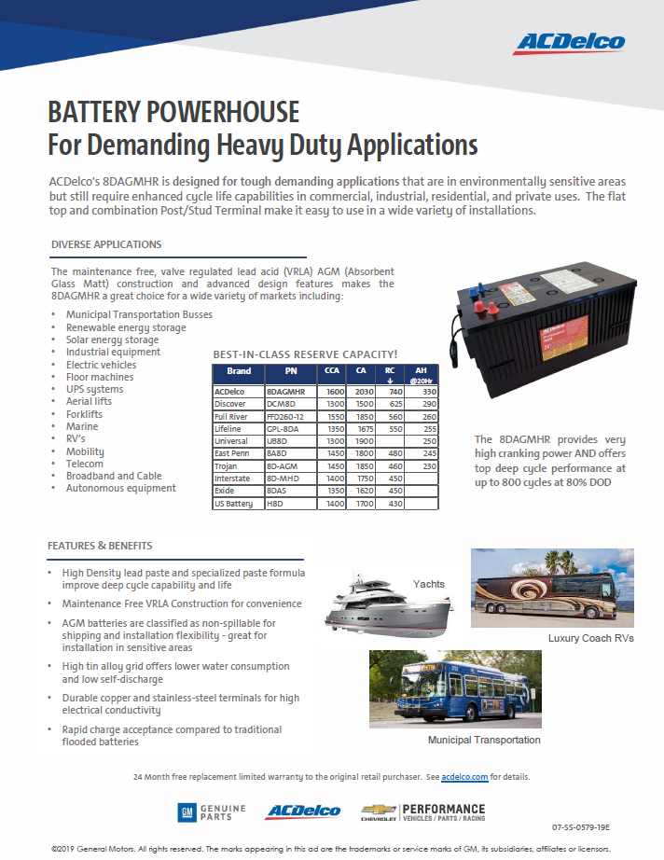
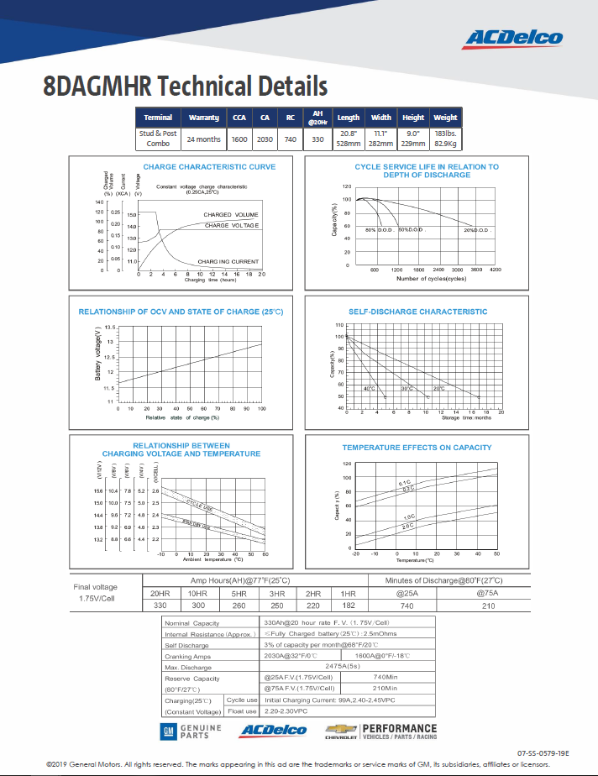
8DAGMHR Sell Sheet Released
Features and Benefits
  800 cycles at 80% DOD
  Best in class RC
  Highest CCA
Example Applications
Technical Graphs
07-SS-0579-19E
Understand this is a specialty product - key customer base
Notes:
Less $$ then pure lead Odyssy, Northstar, Optima
DOUBLE the cycles

Slide 19
New Pallet Quantities = New Part Numbers
Need for industry standard pallets driving change due to:
  Global alignment, Common inventory management
  Growing use of gravity fed racking
  Safety issues with old pallet
System limitation: 1 PN = 1 Pallet Quantity
  To avoid backorders (wait for sell down) or payment and record errors (if change pallet quantity while inventory is present and in-transit) Best trade-off is to change PNs to allow sell down of current and simultaneous ordering of new
Change 71 PNs to enable move
  Primarily affects Advantage line
  Standard pallet already used for other PNs and BDC shipments
  NO changes* to specifications, costs, or labeling
Bulletin 19D-084 Published 15Aug19
  SeaTainer Order form updated with both new PNs and current PNs for reference
    October Production Order for only new PNs
  Continue ordering current PNs from BDC - Supersessions ensure automatic move to new
    BDC Order form updated in batches with other Bulletins
*Note: 2 Parts will see increased specifications to harmonize
with Canadian only versions, but no change in cost
Notes:
Options:
Sell down completely, change over in system, then order stock = 4 - 5 months of severe back orders
Change Pallet Quantity on current PNs = all inventory in system and in transit is wrong - payment / tracking nightmare on all sides
Change PNs to enable ordering new pallets while selling off of old PNs

Slide 20
2020 Q1 Rebates

Slide 21
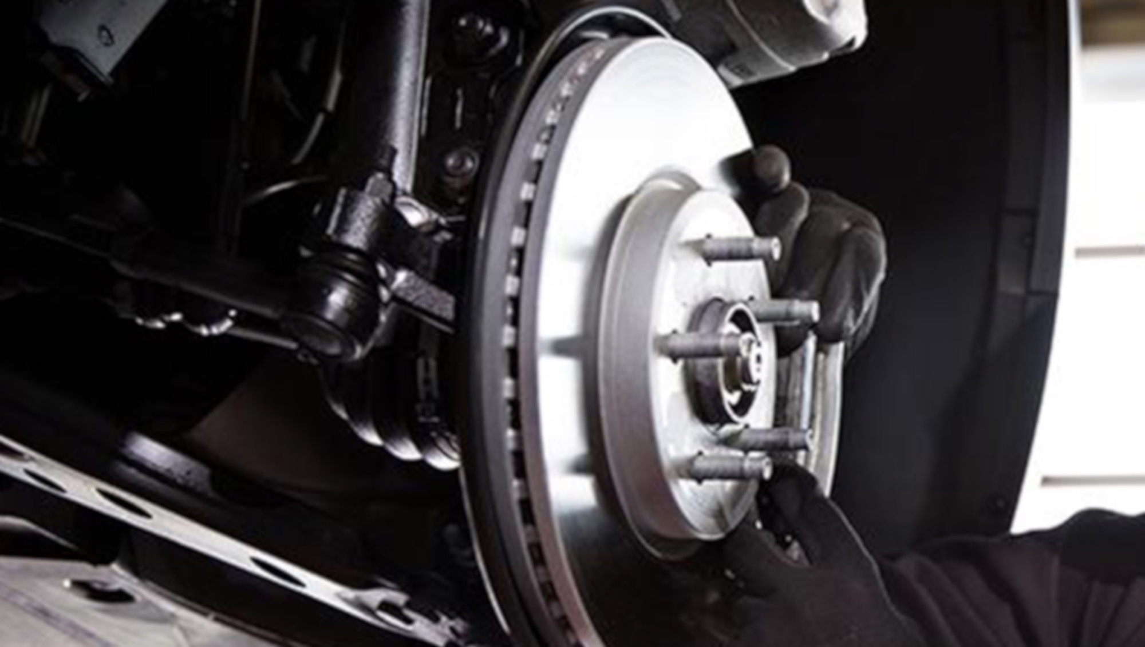

2020 NATIONAL PROMOTIONAL PLAN
INSTALLER PROMOTIONS (NATIONAL)
Q1
Q2
Q3
Q4
JAN
FEB
MAR
APR
MAY
JUN
JUL
AUG
SEP
OCT
NOV
DEC
ONLINE TURNKEY PROMOTIONS
TRADE REBATES
Batteries, MAINTENANCE PACKAGE & POWERTRAIN ASSEMBLY
TRADE REBATES
AIR CONDITIONING, BRAKES, CHASSIS & MAINTENANCE
TRADE REBATES
AIR CONDITIONING, BRAKES, ROTATING ELECTRICAL & MAINTENANCE
TRADE REBATES
MAINTENANCE PACKAGE & POWERTRAINS ASSEMBLY
TRADE OFFERS
INDEPENDENT SHOP PRIVATE OFFERS
PROMOTION via
CONNECTION, REPAIRLINK, COLLISIONLINK
PROMOTION via
COLLISIONLINK
PROMOTION via
COLLISIONLINK
ISC POWERTRAIN
PRIVATE REBATE OFFER
PLUS PARTS-RELATED
BUNDLING OFFER
ISC POWERTRAIN PRIVATE REBATE OFFER
PLUS PARTS-RELATED
BUNDLING OFFER
ISC POWERTRAIN
PRIVATE REBATE OFFER
PLUS PARTS-RELATED
BUNDLING OFFER
CONSUMER OFFERS
Plan subject to change without notice
SPARK PLUG^
INDEPENDENT SHOP CONSUMER REBATES
$1.50 ACDelco Oil Filter^
$5 ACDelco & Professional Fuel Filters^
$5 GM OE & Professional Cabin Filter^
$5 ACDelco Professional Engine Air Filter^
AFTERMARKET CONSUMER OFFERS
DEALER SERVICE LANE CONSUMER REBATES
$10 ACDelco Professional
(includes AGM Batteries)
$5 Advantage Battery (includes AGM Batteries)*
$10 ACDelco Professional
(includes AGM Batteries)
$5 Advantage Battery
(includes AGM Batteries)*
TBD
$200 DEALER SERVICE LANE ENGINE, TRANSMISSION AND TRANSFER CASE CONSUMER REBATE
$200 DEALER SERVICE LANE ENGINE, TRANSMISSION AND TRANSFER CASE CONSUMER REBATE
$200 DEALER SERVICE LANE ENGINE, TRANSMISSION AND TRANSFER CASE CONSUMER REBATE
GM Confidential
*Requires installation at an ACDelco Service Center. Enrollment in GM Partner Perks Tier II or Tier III required.
^Offer is available anywhere ACDelco parts are sold.

Slide 22
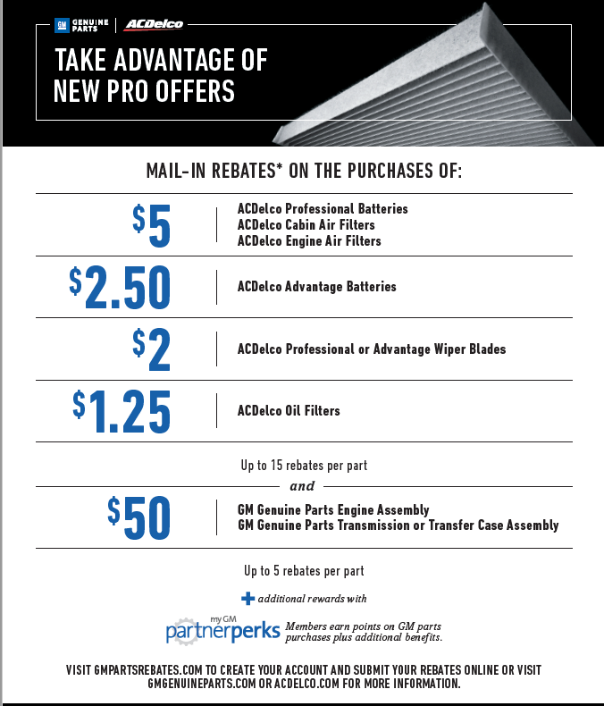

Slide 23
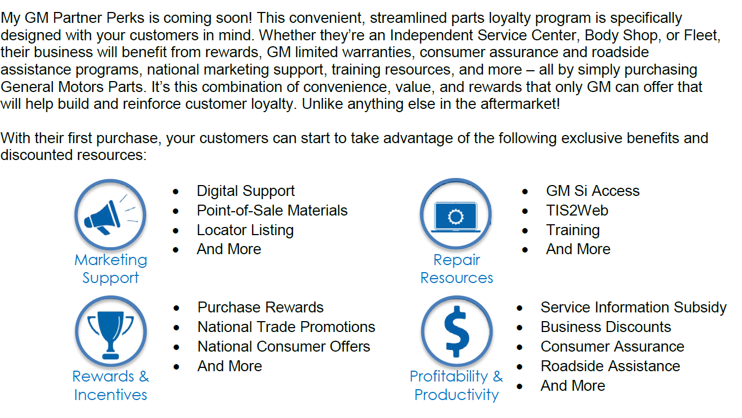
GM Partner Perks loyalty program
Launched 4-2019

